Slide 1

DoctorDesk Project
< Achmet Chasankil />
< Kristiana Hotaj />
<Celil Duman />

Slide 2
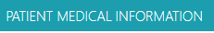
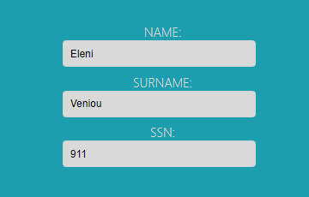
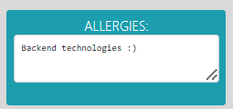
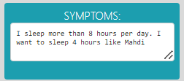
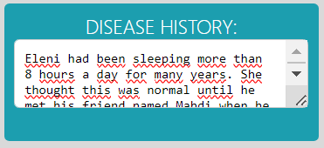
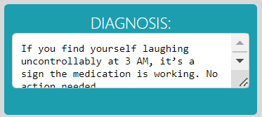
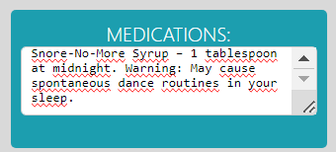
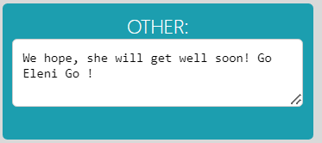
DoctorDesk Project
The aim of the DoctorDesk App is to maintain comprehensive health records for patients undergoing treatment.

Slide 3
Advantages of DoctorDesk Project
By maintaining patient records, the application enables doctors to communicate more swiftly and efficiently about patients.
This enhanced communication allows for rapid intervention in emergency situations.
Quick access to patient information speeds up treatment processes and boosts overall efficiency.
Additionally, in some cases, remote treatment can be conducted without the need for face-to-face interactions between the patient and doctor.

Slide 4
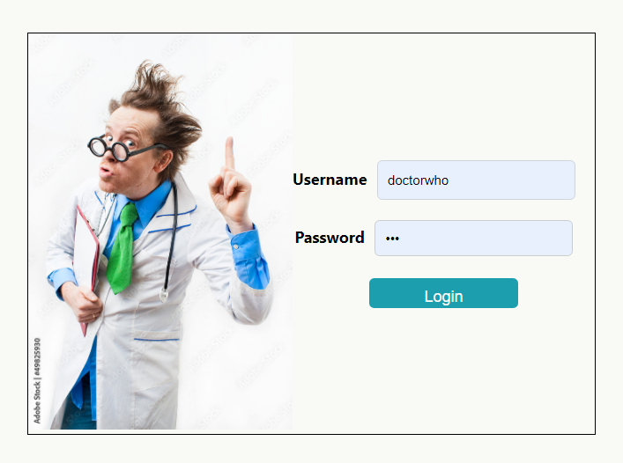
DoctorDesk Project Structure
LOGIN PAGE

Slide 5
DoctorDesk Project
LOGIN PAGE
The user can only log in
with the credentials that
we have created for them
from the database.
After successfully logging in,
the user gets redirected to
the "MAIN PAGE".
CONTINUE >>

Slide 6
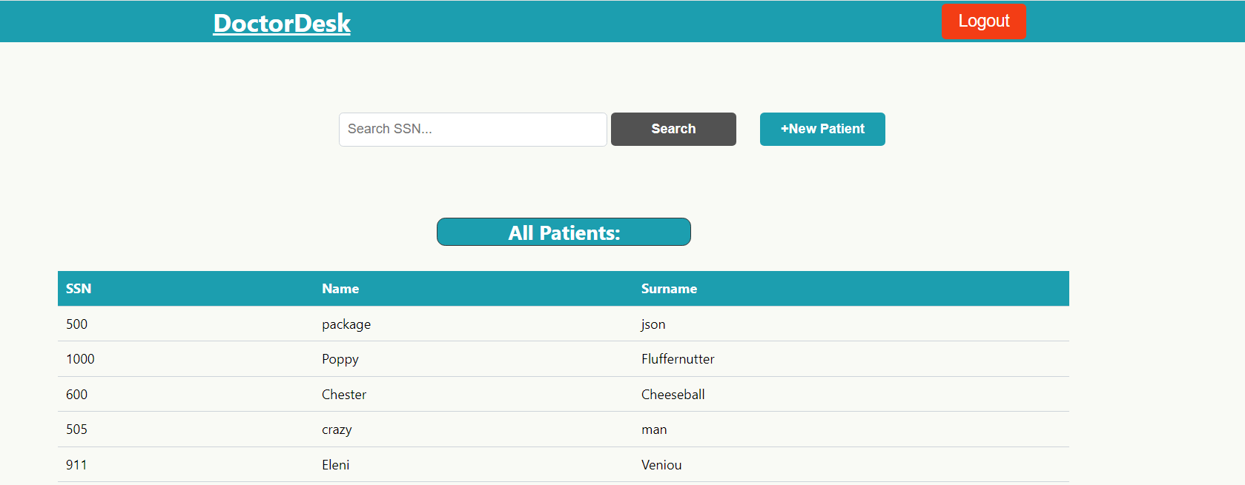
DoctorDesk Project Structure
MAIN PAGE

Slide 7
DoctorDesk Project
MAIN PAGE
The user here can view all
the patients they have added
showing the name, surname and SSN of each patient.
If the user wishes to create a new patient they're able to do that by clicking ''NEW PATIENT" to get redirected to "NEW PATIENT" page.
The user can search a patient by typing in the Search Bar the patient's "SSN" to view all the medical info.
The user can also "CLICK" on a patient to view all the medical info and then the user gets redirected to "PATIENT INFO" page.
CONTINUE >>

Slide 8
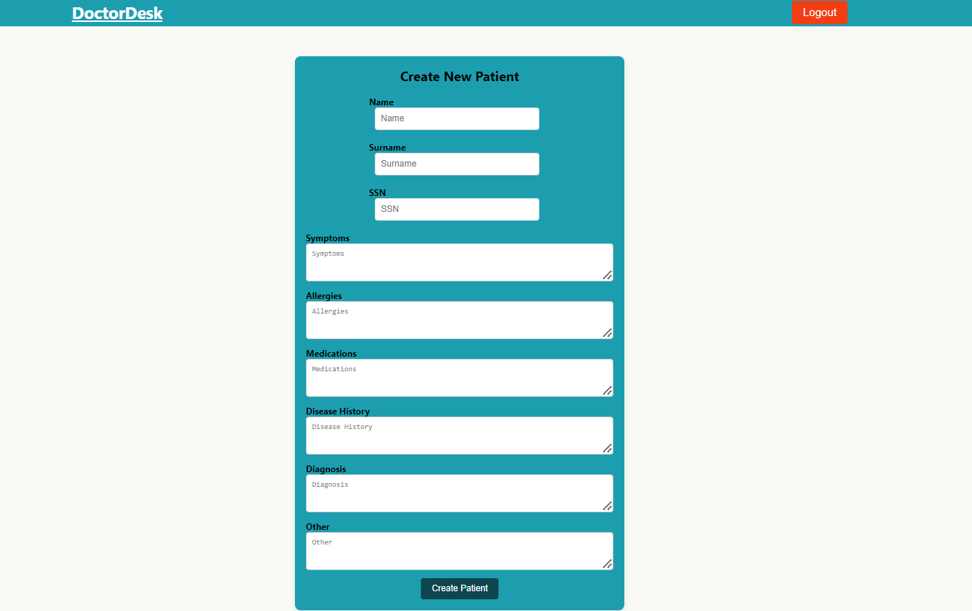
DoctorDesk Project Structure
NEW PATIENT PAGE

Slide 9
DoctorDesk Project
NEW PATIENT PAGE
The user here can see a form where they can add the following info of the patient:
- Name - Symptoms -Disease History - Surname - Allergies -Diagnosis - SSN - Medication -Other
After completing adding any info needed, the user then clicks on "CREATE PATIENT"
button to create a new patient.
After successfully creating the patient, the user gets redirected to "MAIN PAGE".
CONTINUE >>​

Slide 10
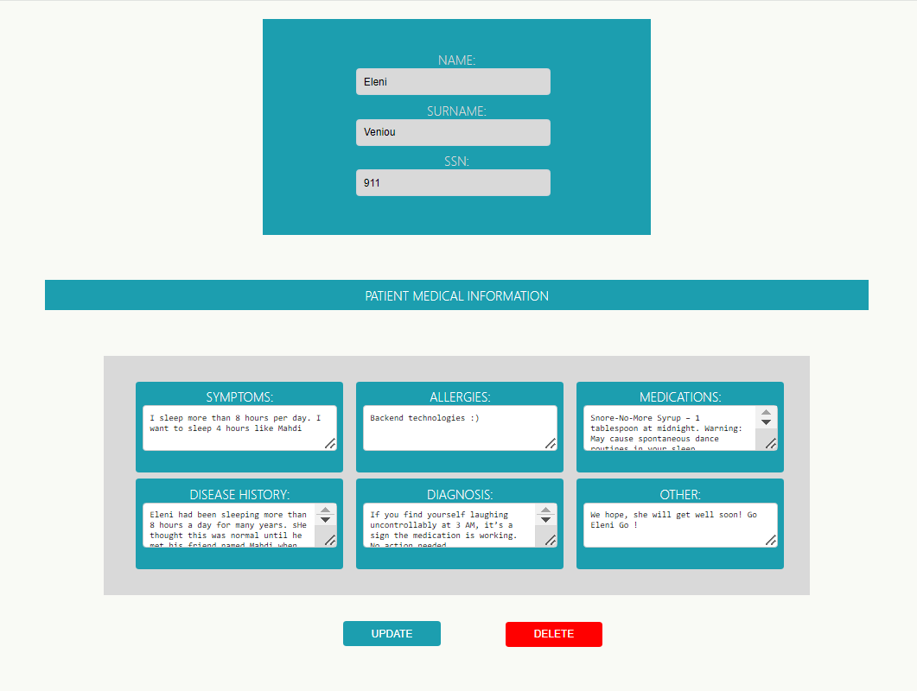
DoctorDesk Project Structure
PATIENT MEDICAL INFO PAGE

Slide 11
DoctorDesk Project
PATIENT MEDICAL INFO PAGE
The user here can view and "EDIT"
all the patient's medical information.
After editing the patient's information,
the user must click "UPDATE" to save the new data of the patient.
After successfully saving the new data, the user gets redirected to "MAIN PAGE".
After successfully deleting the patient, the user gets redirected to "MAIN PAGE".
If the user wishes to delete the patient, they can simply click "DELETE" to remove the patient from the list.
CONTINUE >>

Slide 12

DoctorDesk Project Demo

Slide 13
Thank you !
Open for Q&A

